Slide 1







OrangeHRM
Manual & Automated Testing
Presented By:
Zainab Mohamed Alaa Eldien
Mazen Nagy Eldayaste
Jana Abdullah Adel
Alhassan Abdel Hamed
Soha Mohamed Abd El Wahed
www.reallygreatsite.com

Slide 2


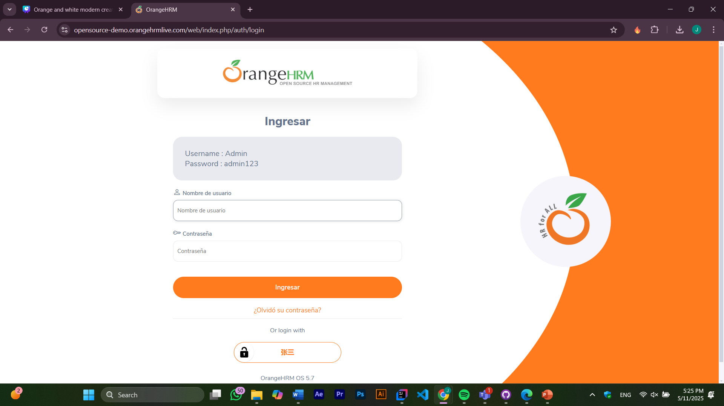
Project Scope
•Tested OrangeHRM: an open-source HR management platform
www.reallygreatsite.com

Slide 3







Project Scope:
Login:
Verify login functionality with valid and invalid credentials.
Logout:
Test user logout behavior and redirection.
Payroll:
Validate payroll features, calculations, and reporting modules.
Functionality Testing:
Ensure all features work as expected.

Slide 4





Project Scope:
Security Testing:
Check authentication, authorization, and data protection.
UI & UX:
Evaluate interface responsiveness, accessibility, and user experience.
Frontend Testing:
Validate client-side elements and browser compatibility.
Session Management:
Test timeout, multiple sessions, and session expiration handling.

Slide 5
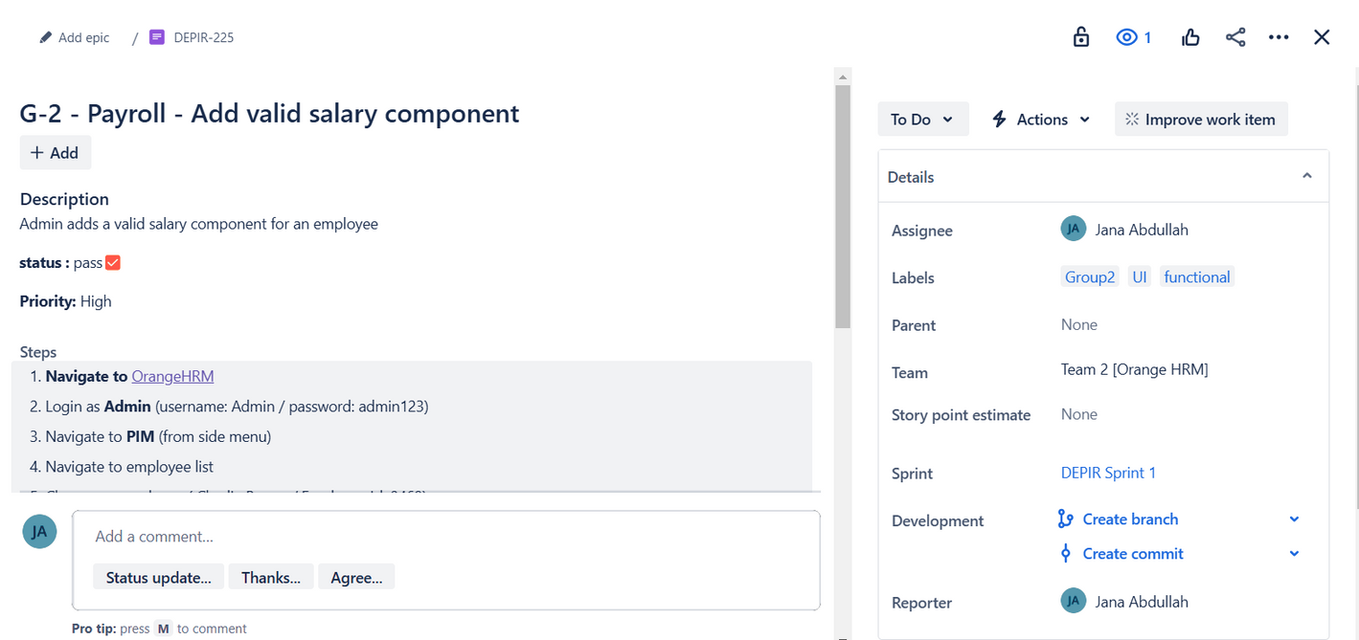
Manual Testing Coverage
Login & Logout
Payroll
Employee Management
Leave Request
Approve Leave Requests
View Employee Records
Manage Payroll
Performance Reviews

Slide 6




Testing Coverage
Total test cases
Failed
test cases
Passed
test cases

Slide 7
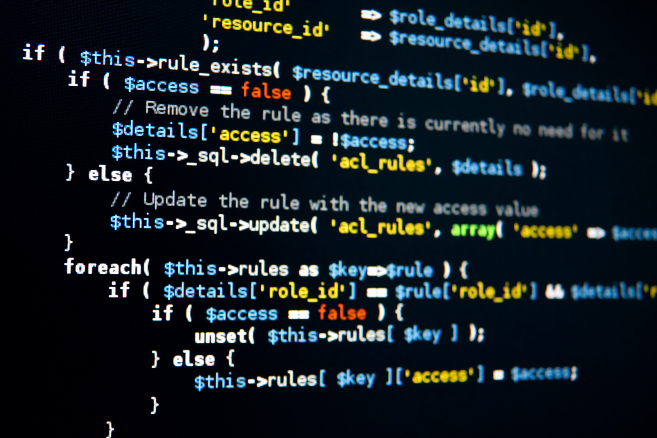

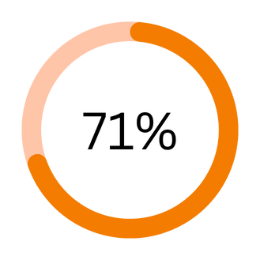
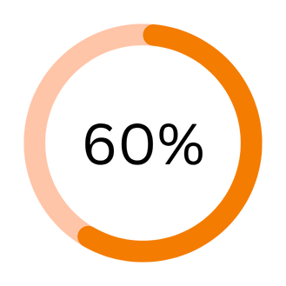
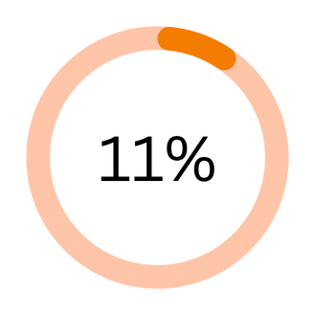
Key Findings & Metrics
KPI 01
KPI 02
KPI 03
Total test cases
Passed test cases
Failed

Slide 8

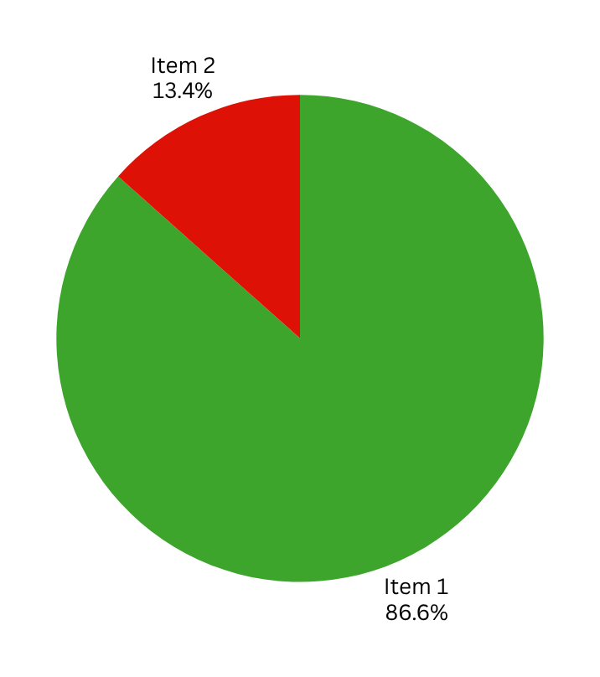

Key Findings & Metrics
01
Test cases
02
Issues

Slide 9



Tools Used:
Java, TestNG, Selenium WebDriver, GitHub, Jira
Framework:
Page Object Model for maintainability
Automation Architecture
Test Suites:
Functional modules organized (login, payroll, etc.)
Version Control:
GitHub
Bug Tracking:
Jira

Slide 10
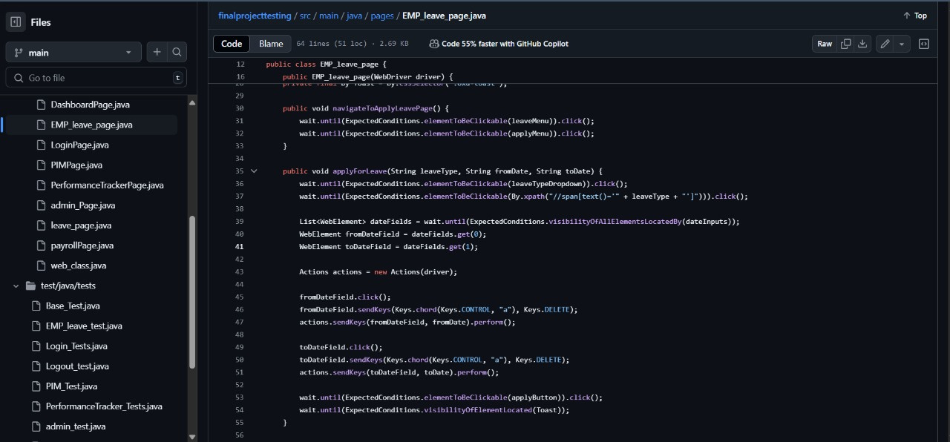
Automation architecture and demo

Slide 11


Challenges & Lessons Learned
01
Dynamic Web Elements:
The OrangeHRM website changed frequently during testing, including UI layout and language settings.
02
These changes caused automation failures and required frequent script updates.
03
Payroll logic required HR anther login than the admin log in to validate calculations.

Slide 12

Challenges & Lessons Learned
Testing a dynamic website like OrangeHRM taught us to stay flexible. Frequent changes during test case creation and execution affected both manual and automated tests. This experience showed us that testing must be continuous and adaptable, and it emphasized the need for maintainable scripts and strong collaboration.

Slide 13




THANK YOU
Calle Cualquiera 123, Cualquier Lugar

